Slide 1
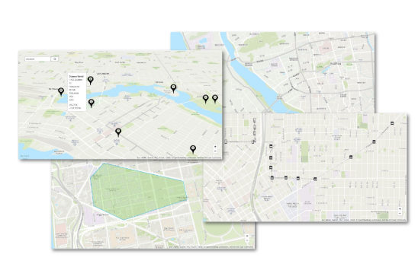

Amazon Location Service

Slide 2
Benefits and features
Access high-quality geospatial data
Seamless integrations with AWS services
Comprehensive data protection and user privacy
Reduce costs – Pay As You Go

Slide 3
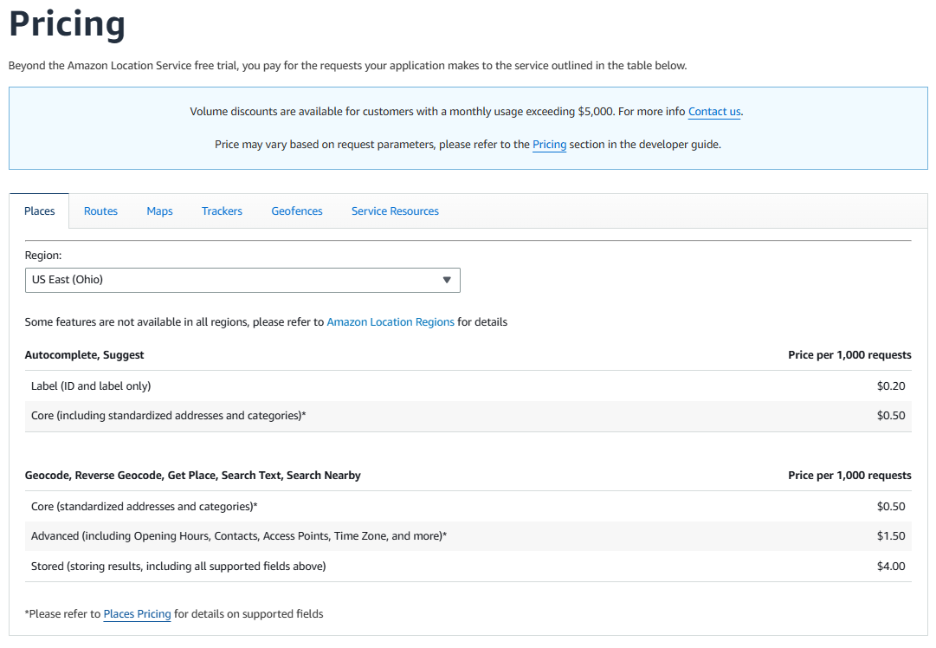
Amazon Location Pricing

Slide 4
Steps
Set up your AWS account and access
Understand and set up authentication
API Key - give read-only access for unauthenticated users
Amazon Cognito - grant anonymous access with a richer authorization.
AWS Identity and Access Management (IAM) - create an IAM policy that allows access to the resources that you want.
Create your first location application by creating place Index.
Choose the right API for Places and Geofences.
Access the data.

Slide 5
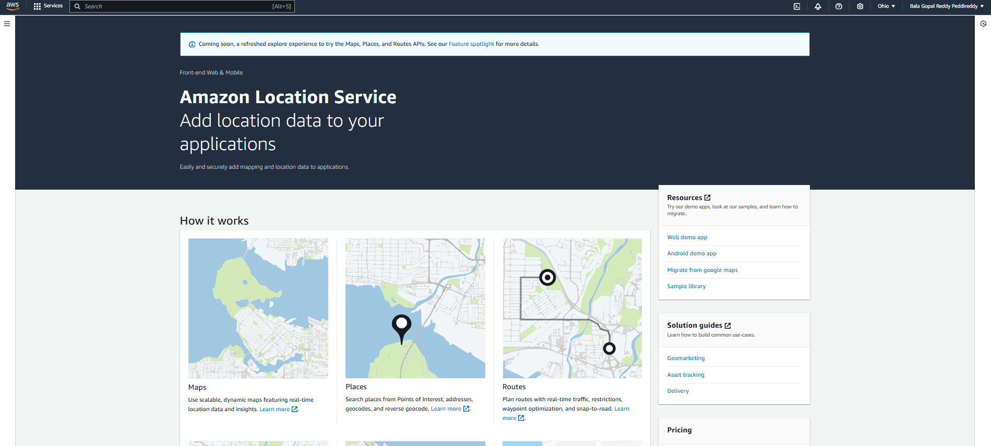

Slide 6
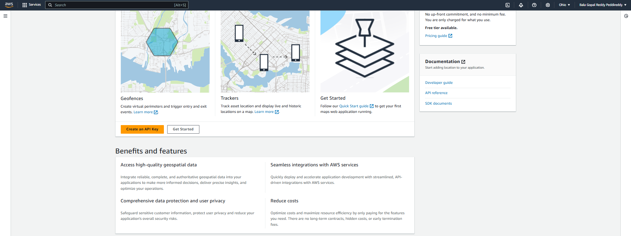
Create API Key

Slide 7
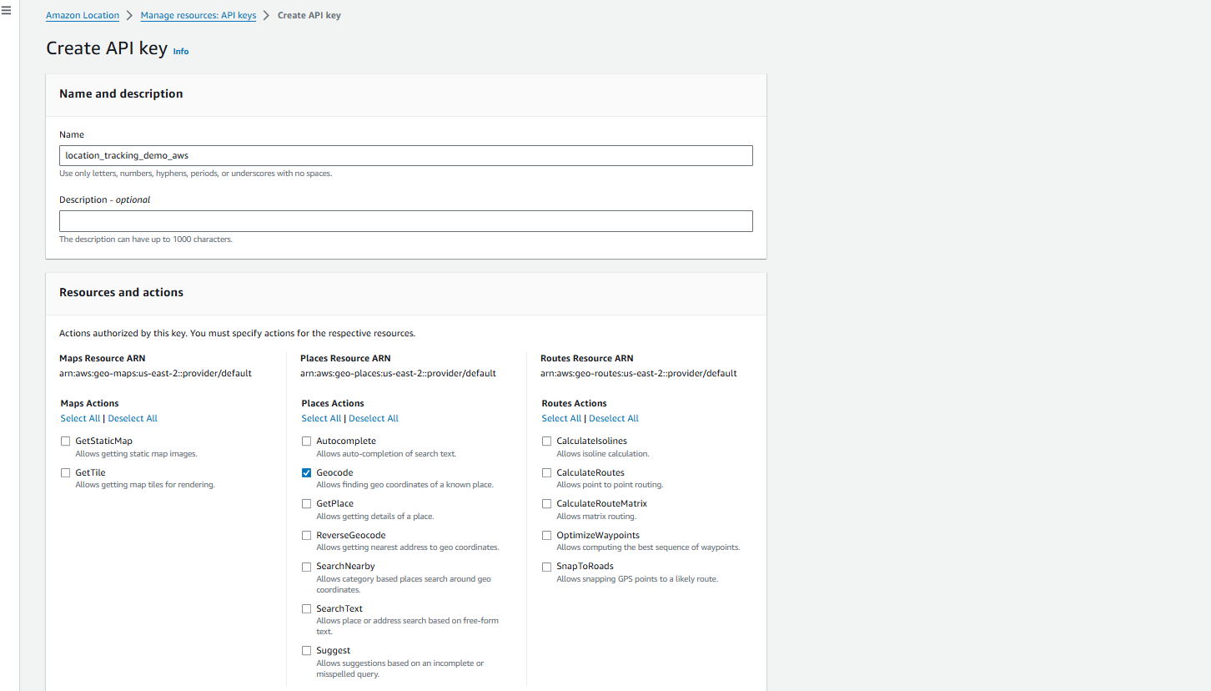
Create API Key

Slide 8
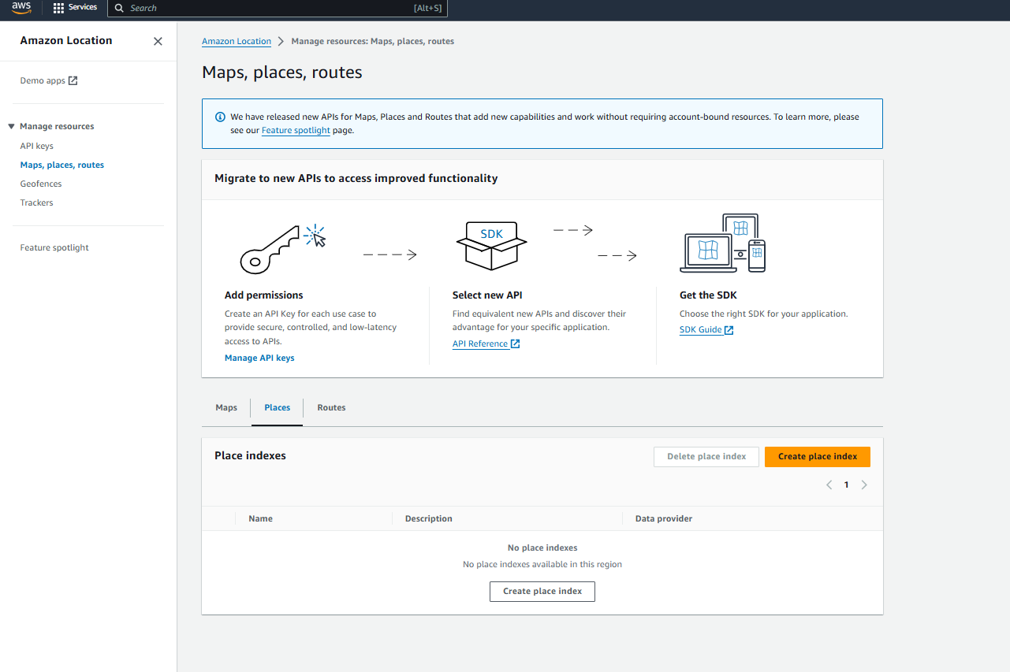

Slide 9
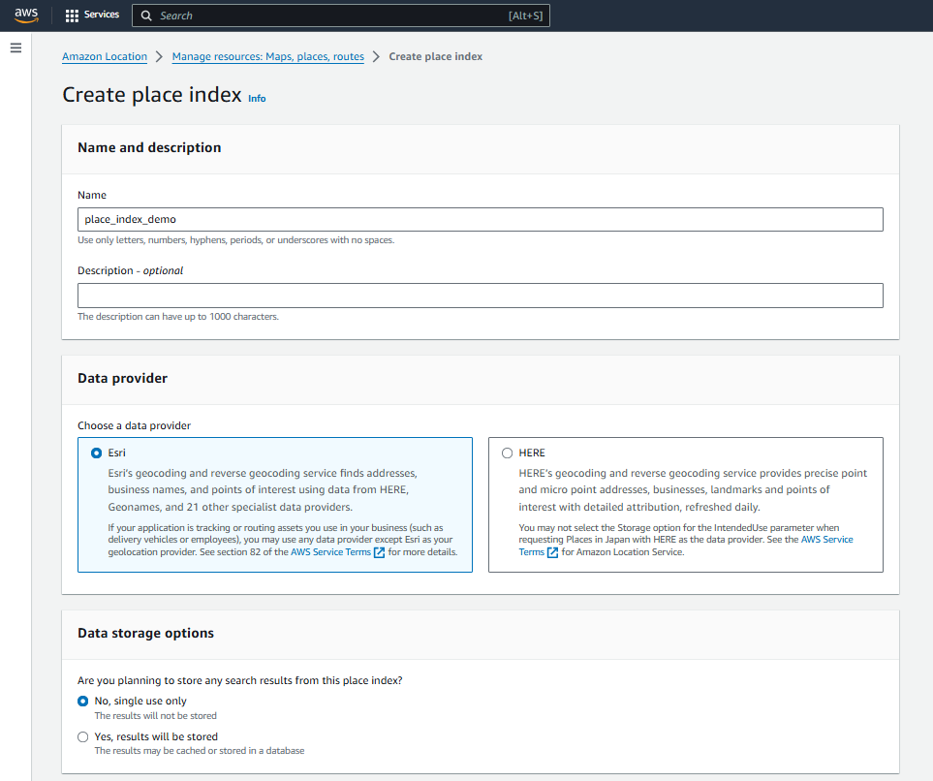
Create Place Index

Slide 10
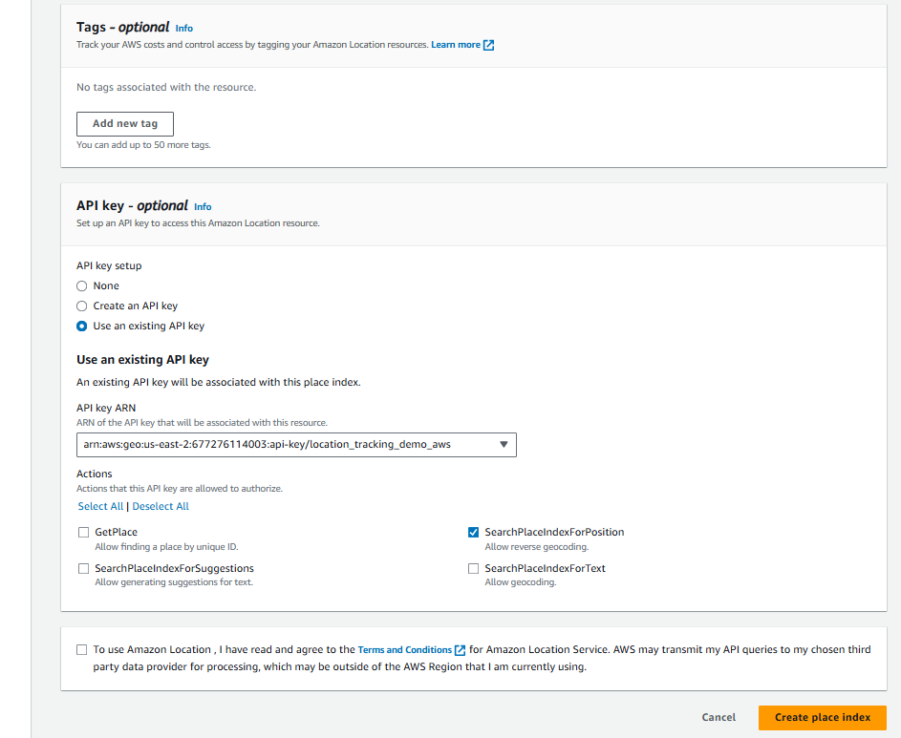
Create Place Index

Slide 11
Coding Steps
Install all the Prerequisites.
Use Environment Variables by configuring AWS Credentials in the Notebook.
Define the reverse geocoding function
Initialize the client
Call the search_place_index_for_position method via API call.
Access the result.

Slide 12
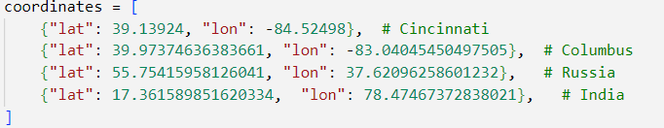
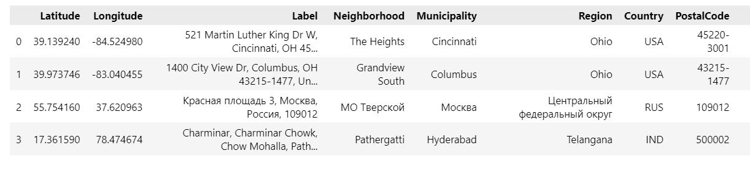
Sample Input
Sample Output

Slide 13
Geo Fences
Talk

